Slide 1
SAN LUIS POTOSÍ TOWARDS SUSTAINABILITY

Slide 2
SUSTAINABLE DEVELOPMENT
GOALS
PARIS AGREEMENT
HABITAT lll
NATIONAL AGENDA

Slide 3
General law of human settlements, land use planning
and urban development.
Long- term planning
Governance implementation
Land rights advocacy
Capacity building
Right to the city
Gender equality
Accessibility
Resilience

Slide 4
Policy development
Metropolitan areas delimitation
Public policy instruments
National land use planning strategy
Institutional development
Statistical tools
Agricultural and land use planning attorney
Guidelines for certification of specialists
Adaptation of state and municipal laws
National and state land use planning and urban development programs
Land use planning and urban development council (national, state and municipal level)
Urban observatories
Land and urban information system

Slide 9
Source: Reporte Nacional de Movilidad Urbana en México 2014-201,5, ONU-Habitat

Slide 10
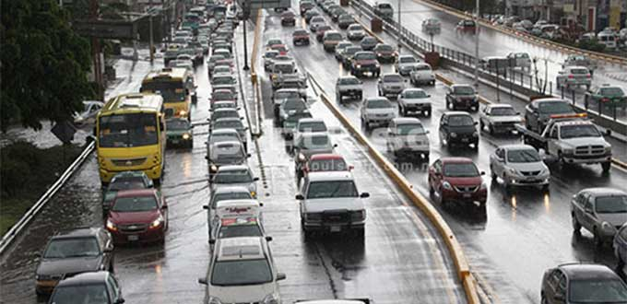
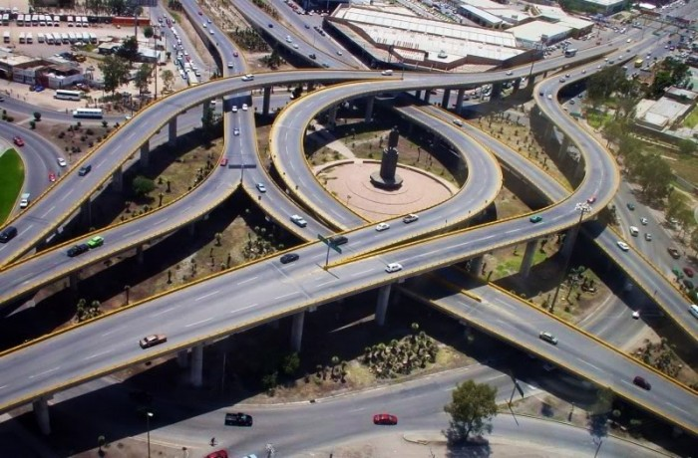
Urban Sprawl
High Segregation
Increased traffic (53% of the emissions are CO2)
Health issues
Difficulty meeting the infraestructure demands
Environmental impact
Social impact
Image: periodico pulso de san luis and san luis en contacto

Slide 11
Installation of state and metropolitan councils
State and muncipal land use planning and urban development programs
Adaptation of the state and municipal law
Information collection and indicators development

Slide 12
Mobility
Waste managment
Land reserve acquisition.
Mobility
Sustainable mobility
Waste managment
Land reserve acquisition.

Slide 13
53,000 passengers per day

Slide 14
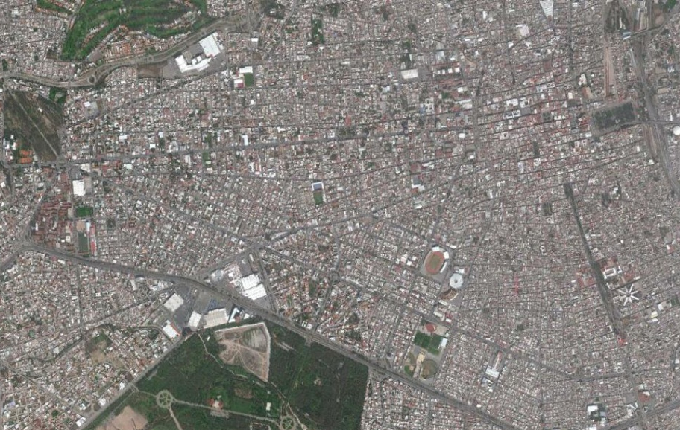
BIKEWAY (19KM)

Slide 15
Enel Green = 100 megawatts
Iberdrola = 200 megawatts
ABB= 1.2 megawatts

